Slide 1


Noida Institute of Engineering and Technology, Greater Noida
Role of Community and Environmental Protection Acts
Unit -V
Subject Name
Environmental Science
Mrs. Sonali Agarwal
Assistant Professor
Civil Department
Course Details Semester –III/IV

Slide 2
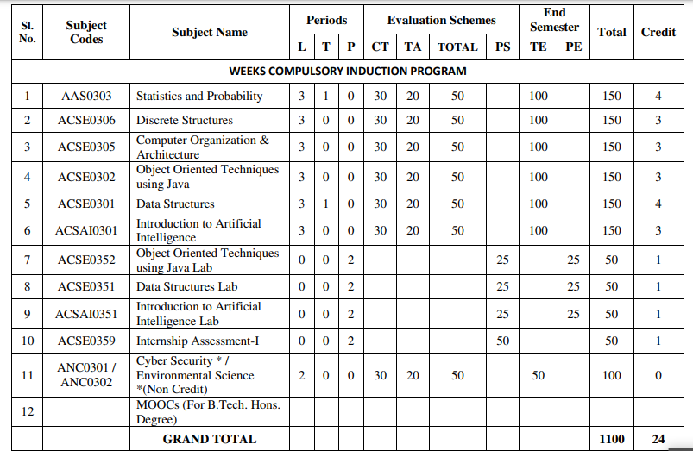
Evaluation Scheme

Slide 3
Syllabus
UNIT-I (Basic Principle of ecology)
Definition, Scope and basic principles of ecology and environment. Ecosystem: Basic concepts, components of ecosystem.
Food chains and food webs. Ecological pyramids, Energy flow in ecological systems, Characteristics of different ecosystems.
Biogeochemical Cycles: Importance, gaseous and sedimentary cycles. Carbon, Nitrogen, Phosphorus and Sulphur Cycles.
Basic concepts of sustainable development, SDGs, Ecosystem services, UN Decade for Eco restoration.

Slide 4
Syllabus
UNIT-II (Natural Resources and Associated Problems)
Natural resources and associated problems.
Forest resources: Use and over-exploitation, deforestation. Timber extraction, mining, dams and their effects on forest and tribal people.
Mineral resources: Use and exploitation, environmental effects of extracting and using mineral resources.
Food resources: World food problems, changes caused by agriculture and over-grazing, effects of modern agriculture, fertilizer-pesticide problems, water logging, salinity.
Land resources: Land as a resource, land degradation, man induced landslides. Equitable use of resources for sustainable lifestyles.
Non Renewable Energy Resources: Fossil fuels and their reserves, Nuclear energy, types, uses and effects,
Renewable Energy Resources: hydropower, Solar energy, geothermal, tidal and wind energy, Biomass energy, biogas and its advantages.

Slide 5
Syllabus
UNIT-III (Biodiversity Succession)
Biodiversity and their importance, Threats to biodiversity, major causes, extinction’s, vulnerability of species to extinction, IUCN threat categories, Red data book.
Strategies for biodiversity conservation, principles of biodiversity conservation in-situ and ex-situ conservation strategies,Mega diversity zones and Hot spots, concepts, distribution and importance.
Succession: Concepts of succession, Types of Succession. Trends in succession. Climax and stability.

Slide 6
Syllabus
UNIT-IV (Pollution and Solid Waste Management)
Air pollution: sources of air pollution, Primary and secondary air pollutants. Origin and effects of SO_{X}, NO_{X}, CO_{X}, CFC’s, Hydrocarbon,, control of air pollution.
Water pollution: sources and types of water pollution, Effects of water pollution, Eutrophication,
Soil pollution: Causes of soil pollution, Effects of soil pollution
Noise Pollution: Major sources of and effects of noise pollution on health,
Radioactive and thermal pollution: sources and their effects on surrounding environment.
Solid waste disposal and its effects on surrounding environment
Climate change, global warming, acid rain, ozone layer depletion,

Slide 7
Syllabus
UNIT-V (Role of Community and Environmental Protection Acts)
Role of community, women and NGOs in environmental protection, Bioindicators and their role, Natural hazards, Chemical accidents and disasters risk management,
Environmental Impact Assessment (EIA)
Salient features of following Acts:
a. Environmental Protection Act, 1986, Wildlife (Protection) Act, 1972.
b. Water (Prevention and control of pollution) Act, 1974.
c. Air (Prevention and control of pollution) Act, 1981. Forest (Conservation) Act, 1980.
d. Wetlands (Conservation and Management) Rules, 2017;
e. Chemical safety and Disaster Management law.
f. District Environmental Action Plan. Climate action plans.

Slide 8
Applications for Emerging Technology
Environmental engineering is the application of science and engineering principles to improve the environment (air, water, and/or land resources), to provide healthful water, air, and land for human habitation and for other organisms, and to remediate polluted sites.

Slide 9
Course Objectives(CO1)
To help the students in realizing the inter-relationship between man and environment and help the students in acquiring basic knowledge about environment.
To develop the sense of awareness among the students about environment and its various problems.
To create positive attitude about environment among the student.
To develop proper skill required for the fulfillment of the aims of environmental education and educational evaluations
To develop the capability of using skills to fulfill the required aims, to realize and solve environmental problems through social, political, cultural and educational processes

Slide 10
Course Outcome
CO 1 | Understand the basic principles of ecology and environment. Ecosystem: Basic concepts, components of ecosystem, food chains and food webs. Ecological pyramids | K1,K2
CO 2 | Understand the different types of natural recourses like food, forest, Minerals and energy and their conservation | K1.K2
CO 3 | Understand the importance of biodiversity, Threats of biodiversity and different methods of biodiversity conservation. | K1,K2
CO 4 | Understand the different types of pollution, pollutants, their sources, effects and their control methods. | K1,K2,K3
CO 5 | Understand the basic concepts of sustainable development, Environmental Impact Assessment (EIA) and different acts related to environment | K1,K2,K3

Slide 11

Topic mapping with CO
Topic | Topic outcome | CO Map | Extend of mapping
Environment and its segment | Students understand the meaning of environment | CO1 | 1
Segment of atmosphere Multidisciplinary nature of EVS Scope and importance of evs | .Students understand different segment of atmosphere Students understand the basic knowledge of basic science Students understand the scope of environmental SC. | CO1 | 1
Food chain and food web | Students understand the definition and types of food chain | CO1 | 2
Ecological pyramid | Students understand the graphical representation of food chain | CO1 | 1
Ecosystem and its types | Students understand the interaction between the biotic and abiotic Components .along its types | CO1 | 1
Components of ecosystem | Students understand the living and non living components | CO1 | 1
Function of ecosystem | Students understand the functions of ecosystems. | CO1 | 2
Forest recourses | Students understand the functions and value of forest | CO1 | 1
Deforestation | Students understand the ill effect and causes of deforestation | CO1 | 1
Mining and transportation activity. | Students understand the ill effects of mining and transportation activity | CO1 | 1
Notes:
Shubhi and Jyoti

Slide 12
Program Outcome (PO’s)
Engineering Knowledge,
Problem Analysis
Design/development of solutions,
Conduct investigations of complex Problems,
Modern tool usage,
The engineer and society,
Environment and sustainability,
Ethics,
Individual and team work,
Communication,
Project management and finance,
Life-long learning

Slide 13
CO-PO Mapping
CO | PO-1 | PO-2 | PO-3 | PO-4 | PO-5 | PO-6 | PO-7 | PO-8 | PO-9 | PO-10 | PO-11 | PO-12
CO1 | 2 | 2 | 1 | 1 | - | 2 | 3 | 2 | 2 | 2 | - | 2
CO2 | 2 | 2 | 1 | 1 | - | 2 | 3 | 2 | 2 | 2 | - | 2
CO3 | 2 | 2 | 1 | 1 | - | 2 | 3 | 2 | 2 | 2 | - | 2
CO4 | 2 | 2 | 1 | 1 | - | 2 | 3 | 2 | 2 | 2 | - | 2
CO5 | 2 | 2 | 1 | 1 | - | 2 | 3 | 2 | 2 | 2 | - | 2
Mean | 2 | 2 | 1 | - | - | 1 | 3 | 2 | 2 | 2 | - | 2

Slide 14
Program Specific Outcome (PSO’s)
Not applicable

Slide 15
COs and PSOs Mapping
Not applicable

Slide 16
Program Educational Objectives (PEOs)
Not applicable

Slide 17
Result Analysis
Not Available (first time included)

Slide 18
End Semester Question Paper Templates

Slide 19
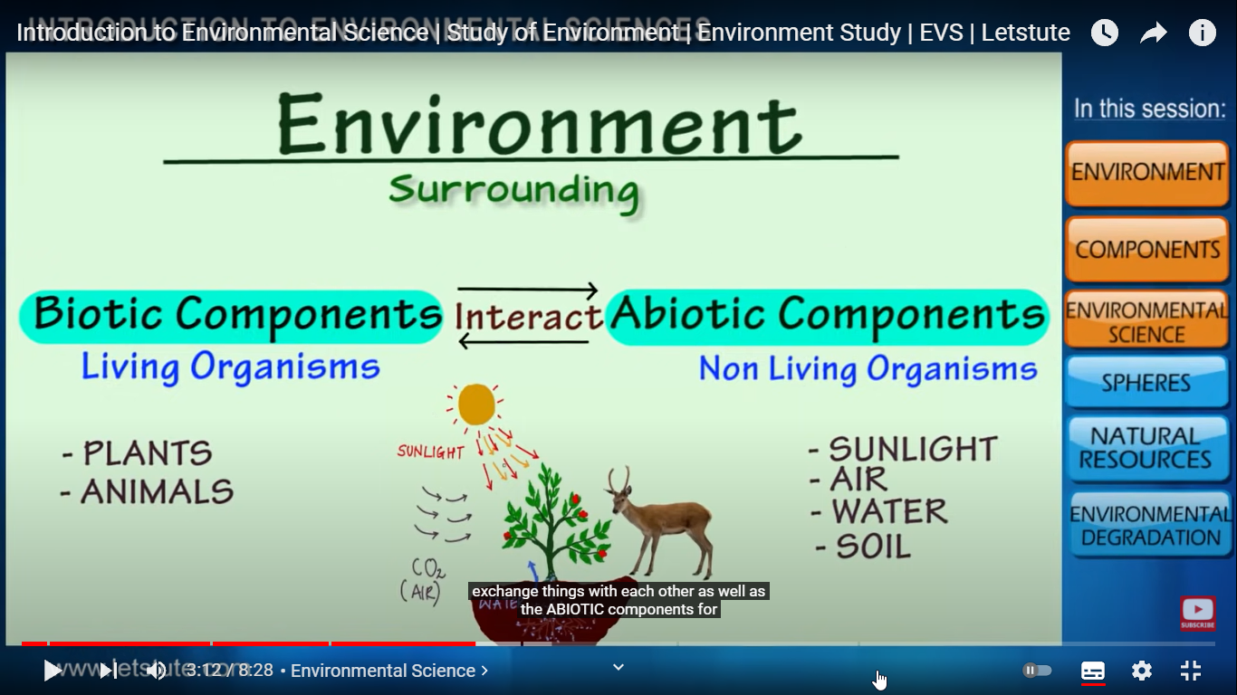
Brief Introduction about the Subject
Environmental studies are the study of human interaction with the environment and in the interests of solving complex problems.
Environment includes which we are directly or indirectly dependent for our survival, whether it is living component like animals, plants or non living component like soil, air and water.
The biologist Jacob Van Uerkal (1864-1944) introduced the term ‘environment’
Video: https://www.youtube.com/watch?v=7G3eXI_DPn8

Slide 20
Syllabus
Unit: V
UNIT-V (Role of Community and Environmental Protection Acts)
Role of community, women and NGOs in environmental protection, Bioindicators and their role, Natural hazards, Chemical accidents and disasters risk management,
Environmental Impact Assessment (EIA)
Salient features of following Acts:
a. Environmental Protection Act, 1986, Wildlife (Protection) Act, 1972.
b. Water (Prevention and control of pollution) Act, 1974.
c. Air (Prevention and control of pollution) Act, 1981. Forest (Conservation) Act, 1980.
d. Wetlands (Conservation and Management) Rules, 2017;
e. Chemical safety and Disaster Management law.
f. District Environmental Action Plan. Climate action plans.

Slide 21
Content
Introduction
Sustainable development
Women education
Role of NGO
Bioindicators and their types
Disasters and their management
EIA and EIS
Different environmental acts

Slide 22
Course Objective(CO5)
To develop the capability of using skills to fulfill the required aims, to realize and solve environmental problems through social, political, cultural and educational processes

Slide 23
Course Outcome(CO5)
 | COORSE OUTCOME
CO 1 | Understand the basic principles of ecology and environment. Ecosystem: Basic concepts, components of ecosystem, food chains and food webs. Ecological pyramids | K1,K2
CO 2 | Understand the different types of natural recourses like food, forest, Minerals and energy and their conservation | K1.K2
CO 3 | Understand the importance of biodiversity, Threats of biodiversity and different methods of biodiversity conservation. | K1,K2
CO 4 | Understand the different types of pollution, pollutants, their sources, effects and their control methods. | K1,K2,K3
CO 5 | Understand the basic concepts of sustainable development, Environmental Impact Assessment (EIA) and different acts related to environment | K1,K2,K3

Slide 24
Topic wise mapping(CO5)
No | Topic | Topic outcome- Students will be able to | CO mapping | Extend of mapping
1 | Sustainable development | Definition.objectives,pillars of sustainable development | CO 5 | 1
2 | Women education | Role of women education regarding en.v protection, schemes for women empowerment | CO5 | 1
3 | Role of NGO | Full form of NGO, Role of NGO,Name of indiaN and international NGO | CO5 | 2
4 | Bioindicators and their types | Name and role of bioindicators regarding environmental protection. | CO5 | 1

Slide 25
Prerequisite and Recap
Basic knowledge of nature

Slide 26
Sustainable development(CO5..)
Sustainable Development Goals
To promote the kind of development that minimises environmental problems.
To meet the needs of the existing generation without compromising with the quality of the environment for future generations.

Slide 27
Sustainable development(CO5..)
Sustainable development can be achieved if we follow the following points:
It can be achieved by restricting human activities.
Technological development should be input effective and not input utilizing.
The rate of consumption should not surpass the rate of salvation.
For renewable resources, the rate of consumption should not surpass the rate of production of renewable substitutes.
All types of pollution should be minimized.
It can be achieved by sensible use of natural resources.

Slide 28
Examples of Sustainable Development(CO5)
Examples of Sustainable Development
Wind energy
Solar energy
Crop rotation
Sustainable construction
Efficient water fixtures
Green space
Sustainable forestry

Slide 29
Environmental Crisis(CO5)
What is Environmental Crisis?
Environmental crisis refers to a situation when an environment fails to perform its vital function of life sustenance. The environment becomes suitable as soon as the following happens:
Resource extraction remains below the rate of resource generation.
Generation of waste remains within the absorption capacity of the environment.

Slide 30
Reasons for Environmental Crisis(CO5)
Reasons for Environmental Crisis
(1) Population explosion
The high rate of growth of population adversely affects the environment.
It increases the demand for environmental resources, but their supply is limited.
This results in overuse and misuse of resources.
(2) Rise in economic activity
The rise in economic growth results in affluent consumption and production of goods and services.
It generates wastes that are beyond the absorptive capacity of the environment.
(3) Rapid industrialization
Rapid industrialization has led to deforestation, and depletion of natural resources.
It leads to contamination of water[3] due to the accumulation of increasing quantity of toxic substances and industrial wastes in the water bodies.

Slide 31
Reasons for Environmental Crisis(CO5)
Urbanisation
A large migration of population from rural to urban areas results in the fast growth of slum areas.
It leads to the excess burden on the existing infrastructural activities.
(5) Deforestation
Deforestation refers to cutting down of trees, clearing forest, etc.
It adversely affects the environment and causes other problems.
(6) Increased use of insecticides, pesticides, and chemical fertilizers
Farmers and workers suffer health problems due to the increased use of poisonous insecticides, pesticides, and chemical fertilizers.
The crop generated also contains chemical elements in it.

Slide 32
Women’s Education in India(CO5)
Women’s Education in India is a long-standing necessity.
Women are often stereotypically viewed as the caretakers of the house. However, in the modern age, women’s rights are being recognized; most importantly, their right to receive an education.
Women need to be given equal opportunities as men, especially when it comes to education.
Women’s education will help to eradicate the discrimination and stigma that women face today. Educated women in India can also contribute to India’s developing economy as well as making India a more socially developed country as well.
There are many schemes in India to help women receive education, which would empower women.

Slide 33
Women’s Education in India(CO5)
Women’s education is essential in urban and rural areas.
The education of women will help to remove the social stigma that surrounds it.
It is the key to eliminating social evils such as female infanticide, dowry, child marriage, harassment, etc.
This will not just help the women of today but of the future generations who can live in a world where gender equality exists.

Slide 34
Women’s Education in India(CO5)
A better social status and gaining the respect of their families and peers is another reason why they must be educated.
Through education, they become aware of their rights. They can contribute to the household financially and have a higher standard of living.
Educating women makes them aware on taking care of their health and hygiene. Women can add to the workforce, and this contribution will reflect on the country’s economy. Empowering women helps in the development of the nation

Slide 35
NGO(CO5)
NGO’s play a significant role in bringing social change in society and development of society. In different parts of the world, it has proven that these organizations have many sides. To be a member of it people need to be educated, enthusiastic and inspired.
society since its inception and never enjoyed benefits that government has facilitated them with. Such as women’s education, STs, and SCs.
NGO’s have given and are still giving their best in eliminating the gender inequality which has also been a practice since earlier times.
Girls face many problems no right to education, forcefully making them marry, not letting them work outside the houses.
Therefore, NGO’s try to eliminate this evil ideology of some societies

Slide 36
NGO(CO5)
NGO’s Are the reason why women are not able to move out of the four walls of the houses and participate in politics, business, social activities.now women have witnessed a whole new world due to the efforts of NGO’s and academic institutions.
We have seen incensement in the number of women workers.
There are many foundations such as Agrani foundation, Eklavya, Sewa and Environmental Action Group etc. Day by day women are seeing new opportunities for themselves due to the help of NGO’s.
The use of technology, level of production, a pattern of utilization is almost same all over the world whereas the world is destroying natural resources to achieve their goals and selfish reasons.
That is why NGO’s take birth to keep eyes on such activities.
There have been many health issues due to the overutilization of natural resources causing pollution which later cause health problems and calamities. In this case,
NGO’s deserve an appreciation as they have done a lot to work for such causes.

Slide 37
CLASSIFICATION OF BIOINDICATOR(CO5)
CLASSIFICATION OF BIOINDICATORS
1) BASED ON THE AIM OF INDICATORS
• COMPLIANCE INDICATORS – For e.g. fish population attributes are measured at the population, community or ecosystem levels and are focussed on issues such as the sustainability of population.
• DIAGNOSTIC INDICATORS – They are used to measure on the individual or sub organism (biomarker) • EARLY WARNING INDICATORS – They focuses on rapid and sensitive response to environmental changes.
• ACCUMULATION INDICATORS – They are distinguished for toxic effects bioindicator, with the effects being studied on different biological organisation level e.g. lichens , mussels etc.

Slide 38
CLASSIFICATION OF BIOINDICATOR(CO5)
BASED ON THE APPLICATIONS OF INDICATORS
• ENVIRONMENTAL INDICATORS – This is a species or group of species responding predictably to environmental disturbances or change (e.g. sentinels, detector, exploiters, accumulators, bioassay organisms). An environmental indicators system is an act set of indicators aiming at diagnosing the state of the environment for environmental policy making.
• ECOLOGICAL INDICATORS – This is a species that is known to be sensitive to pollution, habitat fragmentation or other stresses. The response of the indicator is representative for the community.
• BIODIVERSITY INDICATORS –indicator for species richness of a community. However, the definition has been broadened to measurable parameter of biodiversity including e.g species richness, endemism, genetic parameter, population-specific parameter and landscape parameter

Slide 39
DISASTER(CO5)
A disaster is a destructive event that occurs suddenly and involves loss of life and property. Disasters can be of two types, natural and man-made. It is a sudden accident or a natural catastrophe that causes great damage or loss of life.
NATURAL DISASTERS
Earthquakes, volcanic activity, tsunamis, floods, cyclones, landslides, avalanches and droughts are natural disasters and man has no control over them. They are a result of natural activities and hence known as natural disasters .

Slide 40
DISASTER(CO5)
MAN MADE DISASTERS
The man-made disasters are triggered by human beings.
Some of the man-made disasters are: bomb explosions, terrorism, war or civil war, leakage of poisonous chemicals, breach in dams, air or water pollution, industrial accidents and epidemics. They are known as man made disasters because they occur due to human actions and not natural forces.

Slide 41
EARTHQUAKES(CO5)
An earthquake is a sudden tremor or movement of the earth’s crust, which usually originates at or below the surface. The outer layer of the earth is solid and is divided into many sections known as plates. The point of origin of the earthquake within the crust or mantle is called the seismic focus. Since the focus is often deep below the surface, the location of the earthquake is often referred to as the point on the surface of the earth, vertically above the seismic focus. This point is called the epicentre.
PROTECTION AGAINST EARTHQUAKES
The information about earthquakes and their intensity should be shared with the public through radio, television and newspapers
Construction of buildings based on earthquake-resistant techniques .
Construct buildings over pillars made of concrete and iron that are built deep in the ground
Water, ration, first-aid kits, radios, flash lights, battery, blankets, jackets and fire extinguishers should be stored in safe places.
If inside a building or a house, take cover under a solid surface like a table, or stand in the doorway

Slide 42
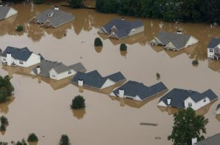
FLOOD(CO5)
A flood is an overflow of a large amount of water beyond its normal limits, especially over what is normally dry land.Flooding may occur as an overflow of water from water bodies, such as a river , lake, or ocean, in which the water overtops or breaks leeves , resulting in some of that water escaping its usual boundaries

Slide 43
EFFECTS OF DROUGHTS(CO5)
EFFECTS OF DROUGHTS
Diminished crop growth or yield productions and carrying capacity for livestock
Dust bowls, themselves a sign of erosion, which further erode the landscape
Dust storms, when drought hits an area suffering from desertification and erosion
Famine due to lack of water for irrigation
Habitat damage, affecting both terrestrial and aquatic wildlife
Hunger, drought provides too little water to support food crops.
Malnutrition, dehydration and related diseases

Slide 44

BIOLOGICAL DISASTER(CO5)
An important type of man-made disaster is biological disaster. Such disasters are caused by microorganisms that cause epidemics. These have spread due to man-made conditions. Most of these have been infectious diseases such as malaria, plague, diphtheria, tuberculosis and influenza.
People can control the spread of these diseases by ensuring hygienic conditions and taking preventive measures. The government has taken a number of steps to contain the spread of these diseases such as fumigation to control the spread of the malarial mosquito

Slide 45
PROTECTION AGAINST BIOLOGICAL AND CHEMICAL DISASTERS(CO5)
People can control the spread of these diseases by ensuring hygienic conditions and taking preventive measures. The government has taken a number of steps to contain the spread of these diseases such as fumigation to control the spread of the malarial mosquito.
Protective clothing: Clothing reduces the risk of mosquito biting if the cloth is sufficiently thick or loosely fitting. Long sleeves and trousers with stockings may protect the arms and legs, the preferred sites for mosquito bites. Schoolchildren should adhere to these practices whenever possible.
Mats, coils and aerosols: Household insecticidal products, namely mosquito coils, pyrethrum space spray and aerosols have been used extensively for personal protection against mosquitoes. Electric vaporizer mats and liquid vaporizers are more recent additions which are marketed in practically all urban areas.

Slide 46
COMMON TECHNIQUES OF DISASTER MANAGEMENT(CO5)
Youth of the country should be encouraged to learn and practise techniques of disaster management .
Education about disaster management should be imparted in schools and colleges
Disaster evacuation drills should be practised in schools and offices
Prepare a first aid box which would be handy in times of disasters .
Details of disaster management squad should be shared through media at every corner of the country.

Slide 47
Environmental assessment stages(CO5)
There are eight guiding principles that govern the entire EIA process: The principles of EIA:
Participation – appropriate/timely access for interested parties
Transparency – open and accessible assessment decisions
Certainty – process/timing agreed in advance
Accountability – decision makers responsible for their actions and decisions
Credibility – undertaken with professionalism/objectivity
Cost effectiveness – environmental protection at the least cost to society
Flexibility – adaptable to deal efficiently with any proposal and decision situation
Practicality – information/outputs readily usable in decision making and planning

Slide 48
WATER ACT(CO5)
THE WATER (PREVENTION AND CONTROL OF POLLUTION) ACT, 1974 • This act provides for the prevention and control of water pollution and the maintenance or restoration of wholesomeness of water. • As such, all human activities having a bearing on water quality are covered under this Act.
Subject to the provisions in the Act, no person without the pervious consent of the State Pollution Control Board (SPCB) can establish any industry, operation or any treatment and disposal system or an extension or addition there to which is likely to discharge sewage or trade effluent into a stream or well sewer or on hand and have to apply to the SPCB concerned to obtain the ‘consent to establish’ as well as the ‘consent to operate’ the industry after establishment.

Slide 49
AIR ACT(CO5)
. THE AIR (PREVENTION AND CONTROL OF POLLUTION) ACT, 1981
The objective of the Air Act 1981 is to prevent, control and reduce air pollution including noise pollution.
Under provisions of this Act, no person shall, without previous consent of the SPCB, establish or operate any industrial plant in air pollution control area the investor has to apply to the SPCB/Pollution Control Committee (PCB) to consent.
No person operating any industrial plant shall emit any air pollution in excess of the standards laid down by the SPCB and have to comply with the stipulated conditions.

Slide 50
THE ENVIRONMENT (PROTECTION) ACT, 1986(CO5)
THE ENVIRONMENT (PROTECTION) ACT, 1986
This is an umbrella Act for the protection and improvement of environment and for matters connected, which provides that no person carrying on any industry, operation or process should discharge or emit or permit to discharged or emitted any environmental pollutant in excess of such standards as may be prescribed.
Several rules relative to various aspects of management of hazardous chemicals, wastes, etc. have been notified. Under this Act, Central Govt. has rusticated, prohibited location of industries in different areas so as to safeguard the environment.
Many standards for air emissions, discharge of effluent and noise have been evolved and notified.
• Subject to the provision of this Act, Central Govt. has the power to take all measures as it deemed necessary for the purpose of protection and improving the environment.
Procedures, safeguards, prohibition and restriction on the handling of hazardous substances along with the prohibition and restriction on the location of industries in different areas have notified.

Slide 51
WILD LIFE ACT(CO5)
The water Act, 1974 (amended 1988) The Water Act was enacted under article 252(1) of the constitution as asocial welfare measure:- • To prevent and control water pollution. • To establish Central and State boards for the prevention and control of water pollution and • To provide and confer powers and functions to the central and state boards to restore wholesomeness of water.
. Wild life Act, 1972 The Act adopted two conservation strategies; i. Specified endangered species are protected regardless of location. ii. All species are protected in specified area. Principles i. To provide protection of wild animals, birds and plants for matters connected with these. ii. To ensure ecological and environment security of the country.
Forest conservation Act, 1980 This act deals with the conservation of forests. The main objectives of this act was to check deforestation. Which was causing:- • ecological imbalance and • deteriorate the environment.

Slide 52
Environmental management Standards(CO5)
ISO 14000 - Environmental management Standards
• That exists to help organizations
a) Minimize how their operations (processes etc.) negatively affect the environment (i.e. cause adverse changes to air, water, or land);
b) Comply with applicable laws, regulations, and other environmentally oriented requirements, and c) Continually improve in the above.
• It does not state requirements for environmental performance, but maps out a framework that a company or organization can follow to set up an effective environmental management system.
• It can be used by any organization that wants to improve resource efficiency, reduce waste and drive down costs

Slide 53
Faculty Video Links, Youtube & NPTEL Video Links and Online Courses Details
Self Made Video Link:
Youtube/other Video Links
https://www.youtube.com/watch?v=ad9KhgGw5iA, https://www.youtube.com/watch?v=nW5g83NSH9M, https://www.youtube.com/watch?v=xqSZL4Ka8xo, https://www.youtube.com/watch?v=WAI-hPRoBqs, https://www.youtube.com/watch?v=o-WpeyGlV9Y, https://www.youtube.com/watch?v=EDmtawhADnY

Slide 54
Daily Quiz(CO5)
1. Any adulterated elements leak into the ground, filtration, and are carried into a groundwater reservoir is known as _____________ .
A) Land contamination
B) Noise pollution
C) Water pollution
D) Air pollution
Answer: C
Q.2 South Africa is a leading exporter of which mineral?
A) Copper
B) Diamond
C) Silver
D) Gold
Answer: D

Slide 55
Daily Quiz(CO5)
Q.3 In which year did the word ‘sustainable development’ come into existence?
A) 1992
B) 1978
C) 1980
D) 1987
Answer: C
Q.4 In which year was the United Nations Commission on Sustainable Development (CSD) started by the UN General Assembly?
A) 1995
B) 1994
C) 1993
D) 1992
Answer: D

Slide 56
Daily Quiz(CO5)
5 Mercury and lead are toxic elements that cause ________________ .
A) Noise pollution
B) Air pollution
C) Water pollution
D) Land contamination
Answer: D
Q.6 What is the other word for landscaping?
A) Reduction
B) Restoration
C) Removing topsoil
D) Restore
Answer: B

Slide 57
Daily Quiz(CO5)
7. _____________development meets the needs of the present generation without compromising the ability of the future generation.
(a) Sustainable
(b) Original
(c) Balanced
(d) None of the above
Answer a
8.Which of the following is the feature of Sustainable Development?(a) Raises per capita income (b) Rational use of Natural Resources (c) No increase in Pollution
(d) All of the above
Answer---d
9._____________development promotes the kind of development that minimizes environmental problems.(a) Sustainable (b) Original (c) Balanced
(d) None of the above Answer ----d

Slide 58
Daily Quiz
10.Following is (are) the element(s) of sustainable agriculture
(A) permaculture
(B) agro forestry
(C) mixed farming
(D) all of the above
Answer-----D

Slide 59
MCQ s(CO5)
1.Name the online platform launched by the Ministry of Women and Child Development to support women entrepreneurs? A. Digital India B. Mahila E-haat C. One Stop Centre Scheme D. None of the above Ans. B
2.The Central Social Welfare Board was established in.... A. 1950 B. 1951 C. 1952 D. 1953 Ans. D

Slide 60
MCQ s(CO5)
3.Indira Gandhi Matritva Sahyog Yojana was launched in... A. 2008 B. 2010 C. 2012 D. 2015 Ans. B 4.National Mission for Empowerment of Women was launched on: A. 15 August, 2010 B. 15 August, 2011 C. 15 October, 2010 D. 15 October, 2011 Ans. B
5.Which scheme promotes community participation through involvement of Students Volunteers for empowerment of rural women? A. NAND-GHAR YOJANA B. eSamvad Portal C. Pradhan Mantri Mahila Shakti Kendra scheme D. She-Box Portal Ans. C

Slide 61
MCQ s(CO5)
6.Name the online platform launched by the Ministry of Women and Child Development to support women entrepreneurs? A. Digital India B. Mahila E-haat C. One Stop Centre Scheme D. None of the above Ans. B
7.The Central Social Welfare Board was established in.... A. 1950 B. 1951 C. 1952 D. 1953 Ans. D

Slide 62
MCQ s
8-The United Nations Conference on Sustainable Development (UNCSD) is also known as
(A) Rio 2010
(B) Rio 2011
(C) Rio 2012
(D) Rio 2013
Answer---C
9 Which of the following options is correct when we only accomplish two out of three pillars of sustainable development?
A) Economic + Environmental sustainability = Viable
B) Social + Environmental sustainability = Bearable
C) Social + Economic sustainability = Equitable
D) All of the above
Answer-----D
10 In which year did the word ‘sustainable development’ come into existence?
A) 1992
B) 1978
C) 1980
D) 1987
Answer-----C

Slide 63
Old Question Papers
NEW SYLLABUS AUTONOMUS

Slide 64
Summary(CO5)
Sustainable development is development that meets the needs of the present without compromising the ability of future generations to meet their own needs. Sustainable development has continued to evolve as that of protecting the world's resources while its true agenda is to control the world's resources
Women’s Education in India is a long-standing necessity.
Women are often stereotypically viewed as the caretakers of the house. However, in the modern age, women’s rights are being recognized; most importantly, their right to receive an education.
NGO’s play a significant role in bringing social change in society and development of society. In different parts of the world, it has proven that these organizations have many sides. To be a member of it people need to be educated, enthusiastic and inspired.society since its inception and never enjoyed benefits that government has facilitated them with. Such as women’s education, STs, and SCs.

Slide 65
Summary
Biological indicators are species :used by observers to determine how various conditions in an environment have changed over time. used to monitor the health of an environment or ecosystem
That can tell us about the cumulative effects of different pollutants in the ecosystem and about how long a problem may have been present, which physical and chemical testing cannot.
A disaster is a destructive event that occurs suddenly and involves loss of life and property. Disasters can be of two types, natural and man-made. It is a sudden accident or a natural catastrophe that causes great damage or loss of life.
The man-made disasters are triggered by human beings. Some of the man-made disasters are: bomb explosions, terrorism, war or civil war, leakage of poisonous chemicals, breach in dams, air or water pollution, industrial accidents and epidemics. They are known as man made disasters because they occur due to human actions and not natural forces.
.

Slide 66
REFERENCES
1. Environmental studies and Environmental engineering –By Dr. H.H.Singh
2. A Text Book of environmental Science By Shashi Chawala
3. Environmental Studies By Dr B.S.Chauhan
.

Slide 67
Noida Institute of Engineering and Technology, Greater Noida
Thank You

